Slide 1

Dr Mahalingam College of Engineering & Technology
Department of Computer Science and Engineering Project Viva Voce
First Review
Team Number: 19BCSB18
Domain: Recommendation System [Data Mining]
Title: Crop Recommendation System using Neural Networks
Guide : J.Bhavithra (AP/CSE)
Team Members: M.Sneaha 15BCS076
M.Susilkumar 15BCS094
A.Vignesh 16BCS316
Date: 14/07/2018

Slide 2
Contents
Objective
Problem Statement
Literature Identified and Findings
Module Description
Software and Hardware Requirements
Data Set (if Applicable)
Screen Shot
References
Online Certification Courses
Weekly Plan

Slide 3
Objective:
To Create a application which effectively recommend the crop based on the attributes:
Weather
Effects of soil
Duration of crop cultivation
Availability of resources
Nutrient Content

Slide 4
Problem Statement:
CROP RECOMMENDATION SYSTEM USING NEURAL NETWORK BASED RECOMMENDATION SYSTEM.

Slide 5
Domain
Neural Networks in data mining
Neural Networks and Data Mining. An Artificial Neural Network, often just called a neural network, is a mathematical model inspired by biological neural networks. A neural network consists of an interconnected group of artificial neurons, and it processes information using a connectionist approach to computation.

Slide 6
Literature Identified and Findings

Slide 7
Information Processing And Management
Filter bubble And Serendipity Problem.
Serendipity in Recommender Systems.
Knowledge Infusion Process
RWR-KI(Graph Based)
Experimental Evaluation:
Invitro Experiment
Dataset
An Investigation On The Serendipity Problem In Recommender System-----www.Elsevier.com,Macro de Gemmis , Pasquale Lops Giovanni Semeraro , Cataldo Musto

Slide 8
Filter Bubble And Serendipity Problem:
To overcome OPAQUE(Doesn’t know what is hidden)
Using FILTER BUBBLE,we can analyse the past behavior and find other crops which has similar history and use that information to provide suggestions.
To overcome SERENDIPITY known as Self-Referential Loop.

Slide 9
Knowledge Infusion Process
This process mainly concentrate on Knowledge repository and also gives advantage of updation an changes.
There are two steps involved in this process:
Knowledge Extraction And Harmonization.
Reasoning(Network Line Structure)
Reasoning:
The concept uses SPREADING ACTIVATION MODEL algorithm which provides SPREADING ACTIVATION NODES through which search process and information retrieval has going to be done.

Slide 10
RWR_KI
Graph Based recommendation Algorithm Enhanced With KI
RWR => Random Walks With Restarts.
This algorithm concentrates on “Discovery of correlations” along with “Discovery of Serendipitous Items”. It makes a Correlation Matrix through which analysis is going to be done.
Selection of the most representative features for item I1.
Running KI by providing those keywords as clues in order to get new keywords related to I1.
Retrieval of items correlated to I1 by using new keywords provided by KI as input for ranking function.

Slide 11
EXPERIMENTAL EVALUATION
The evaluation is going to be done by “Invitro Experiment”
The main aim of this experiment is to study the trade-off between relevance and unexpectedness of recommendation lists computed by RWR-KI in order to understand whether the suggestions satisfy the personal interests of farmers on the one hand, and encourage the exploration of new areas of potential interests on the other hand.
The evaluation need DATASET and some METRICS:
The Metrics involves:
Relevance Measure
Unexpectedness
Serendipity

Slide 12
Module Description:
Data collection and data cleaning
Data scrubbing, also called data cleansing, is the process of amending or removing data in a database that is incorrect, incomplete, improperly formatted, or duplicated.
Data collection is the process of gathering and measuring information on targeted variables in an established systematic fashion, which then enables one to answer relevant questions and evaluate outcomes.

Slide 13
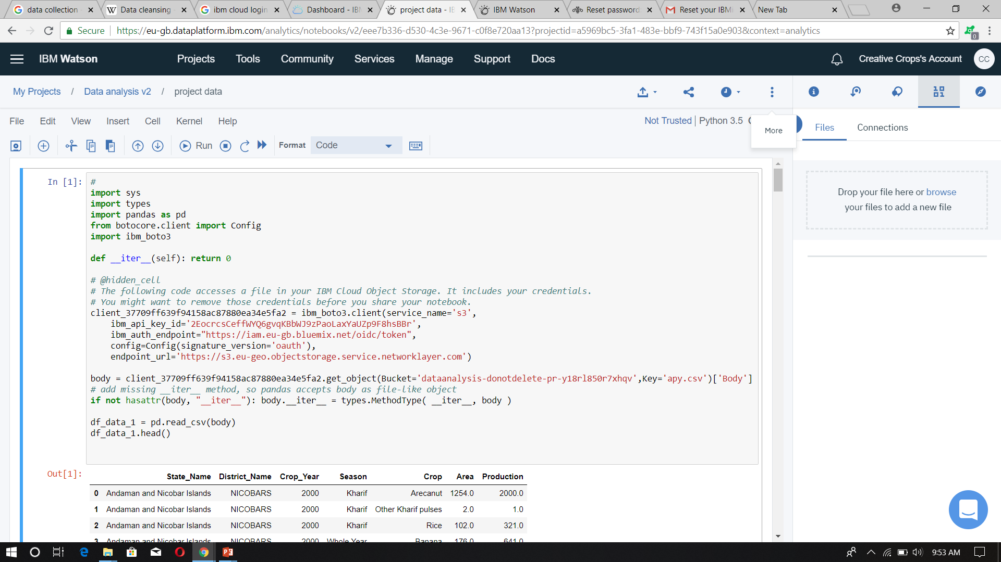

Slide 14
Software Hardware Requirements:
BM's one-stop cloud computing shop provides all the cloud solutions and IBM cloud tools
Environments
Define the hardware size and software configuration for the runtime associated with Watson Studio tools such as notebooks.
4 vCPU and 16 GB RAM

Slide 15
Data Set:
Open Government Data Platform (OGD) India is a single-point of access to Datasets/Apps in open format published by Ministries/Departments.
https://data.gov.in/

Slide 16
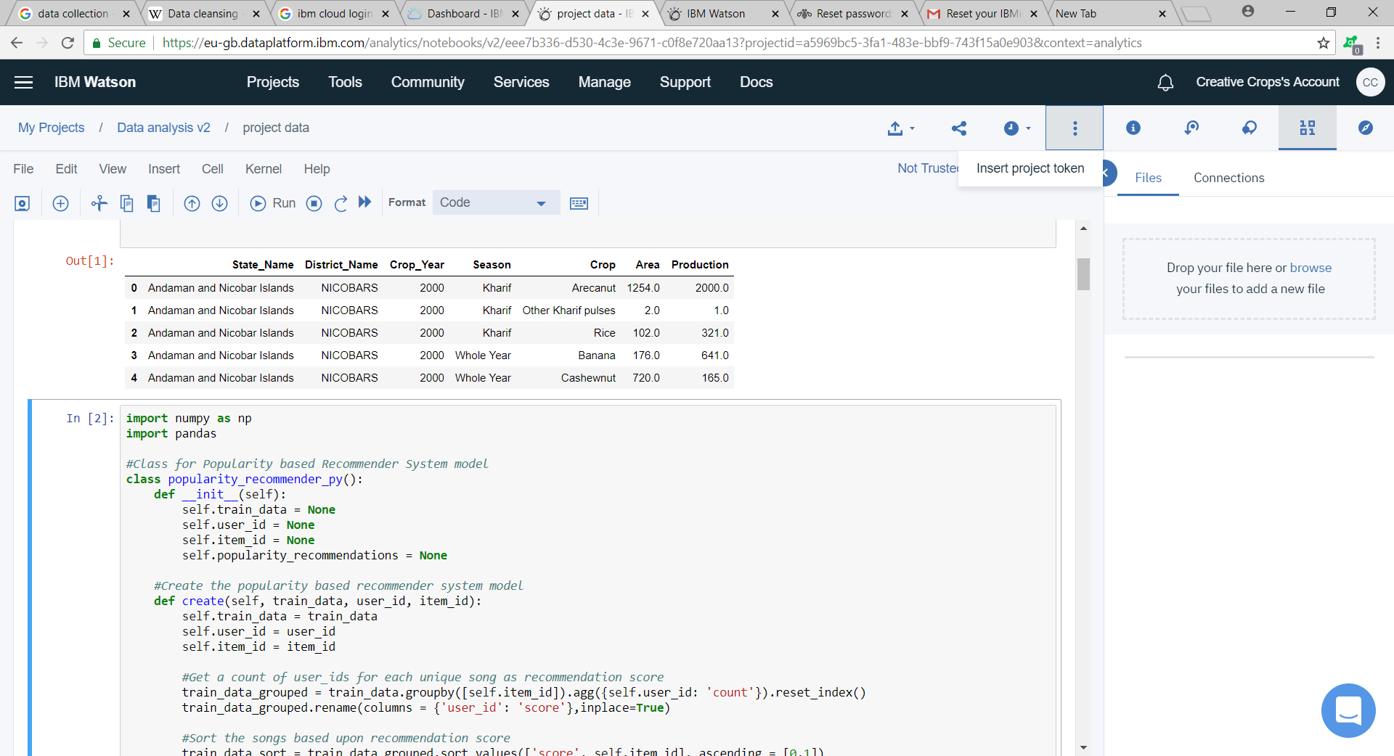
ScreenShots:

Slide 17
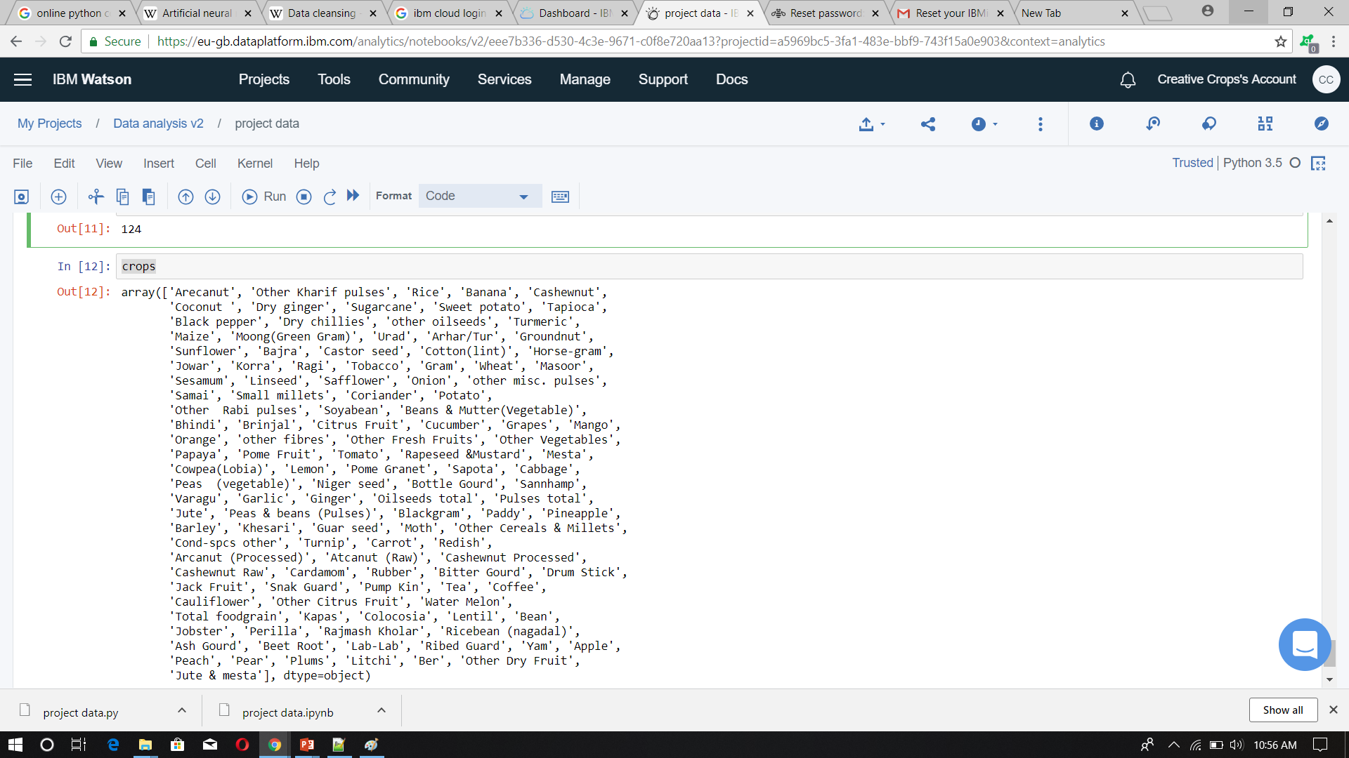

Slide 18
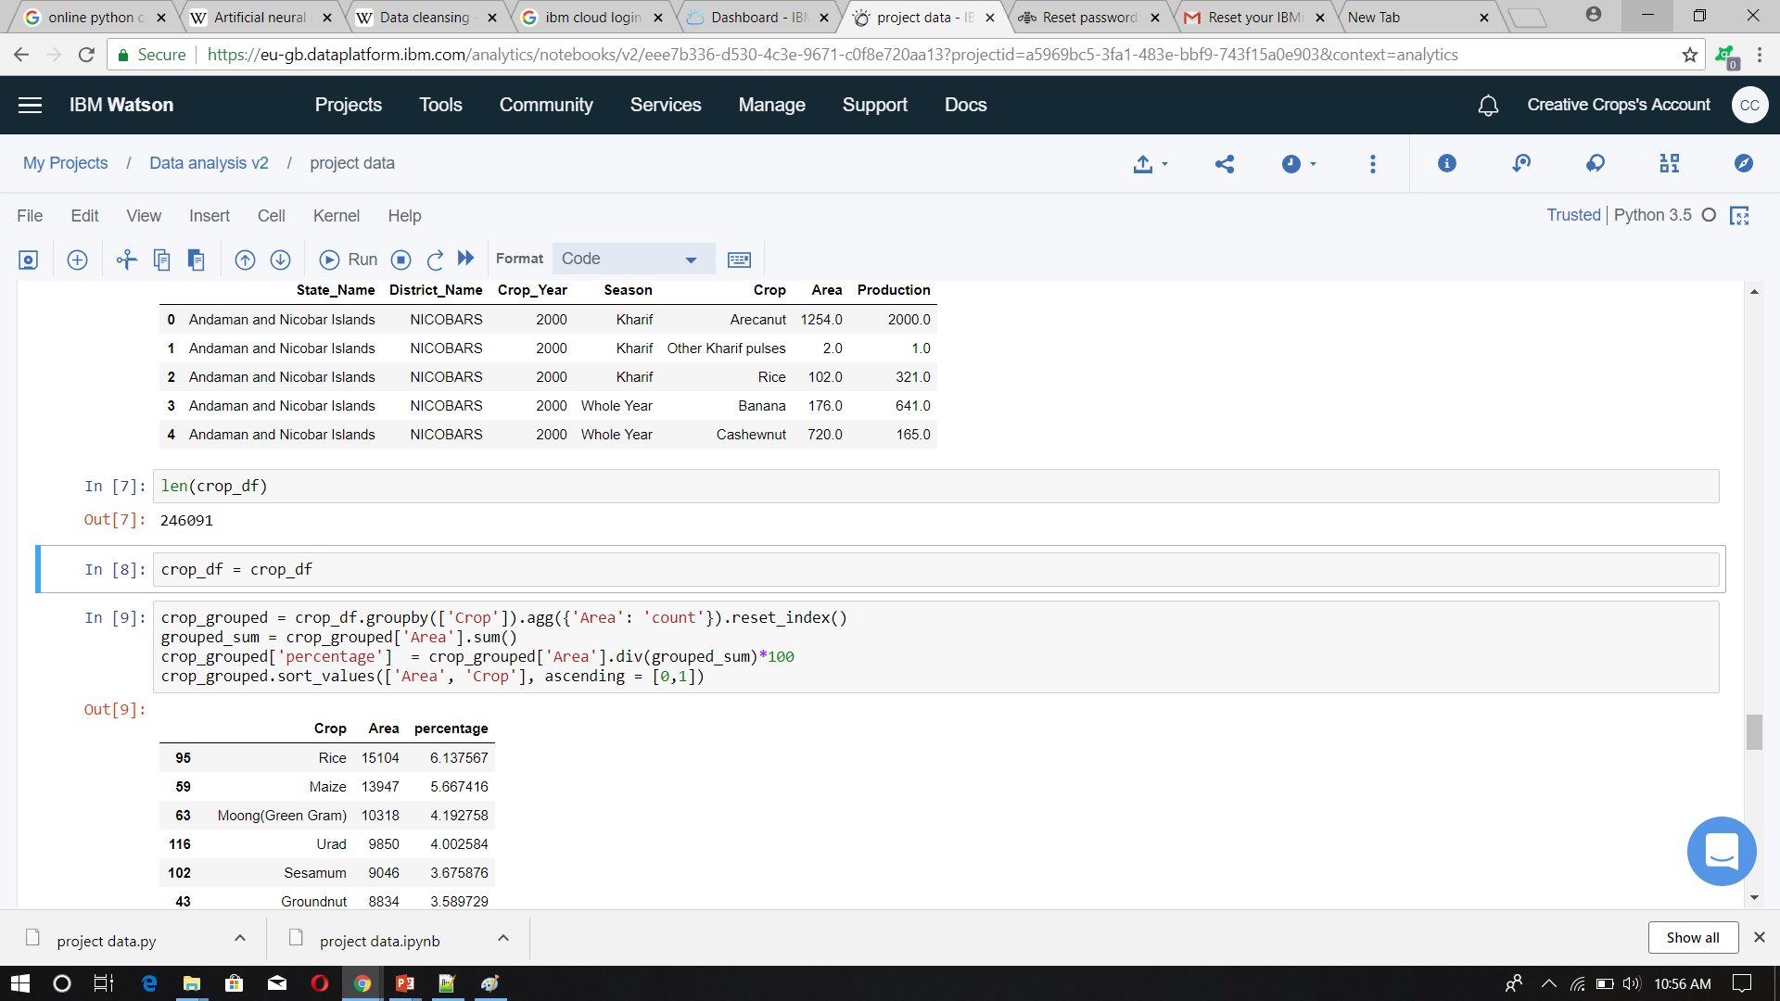

Slide 19
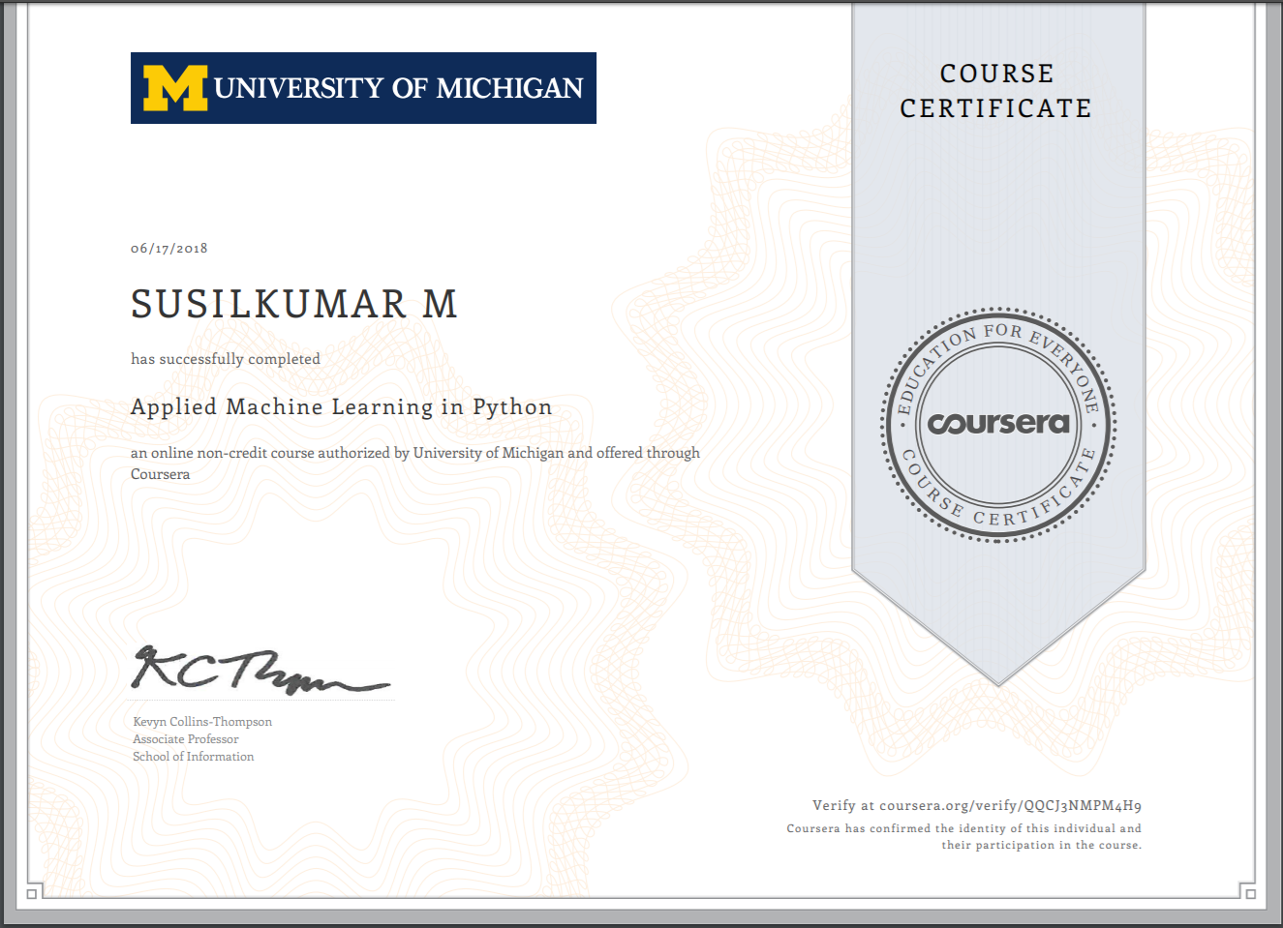
Online Course Certification:

Slide 20
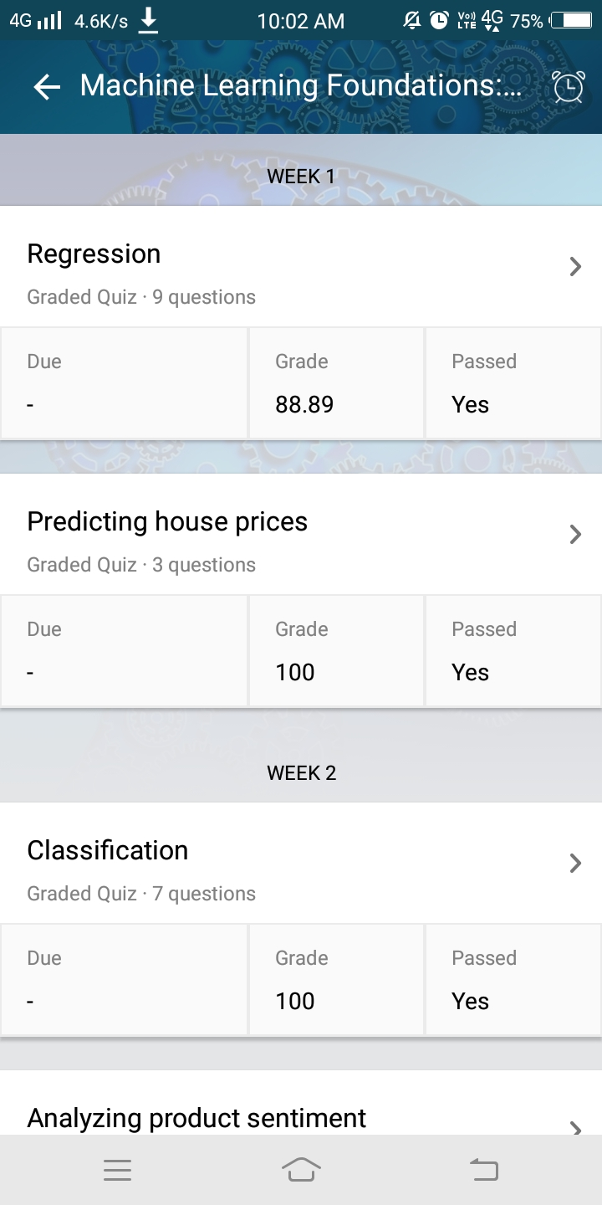
Online Course Certification:

Slide 21
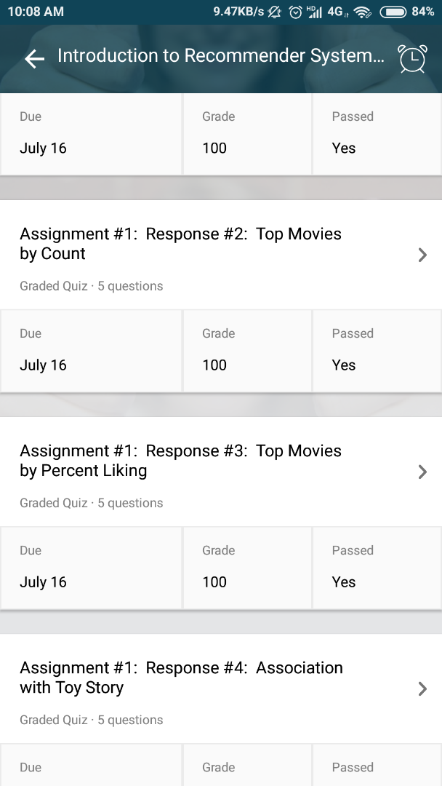
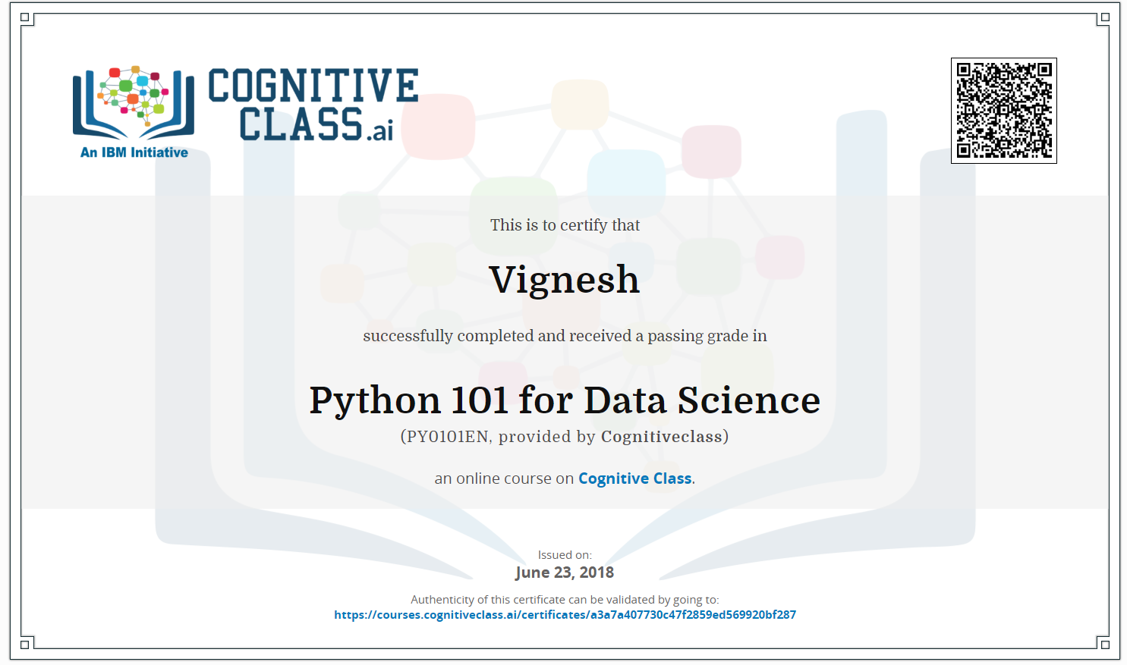
Online Course Certification:

Slide 22
Weekly Plan
Week 1:Search for Data Set.
Week 2:Set the platform by creating Repository using IBM.
Week 3:Base Paper selection and study of existing system.
Week 4:Identifying the reference and supporting papers for the system.
Week 5:Design of flow diagram for the proposed system.
Week 6:Pre processing the data.
Week 7-9:Implementation of modules.

Slide 23
THANK YOU

